Slide 1
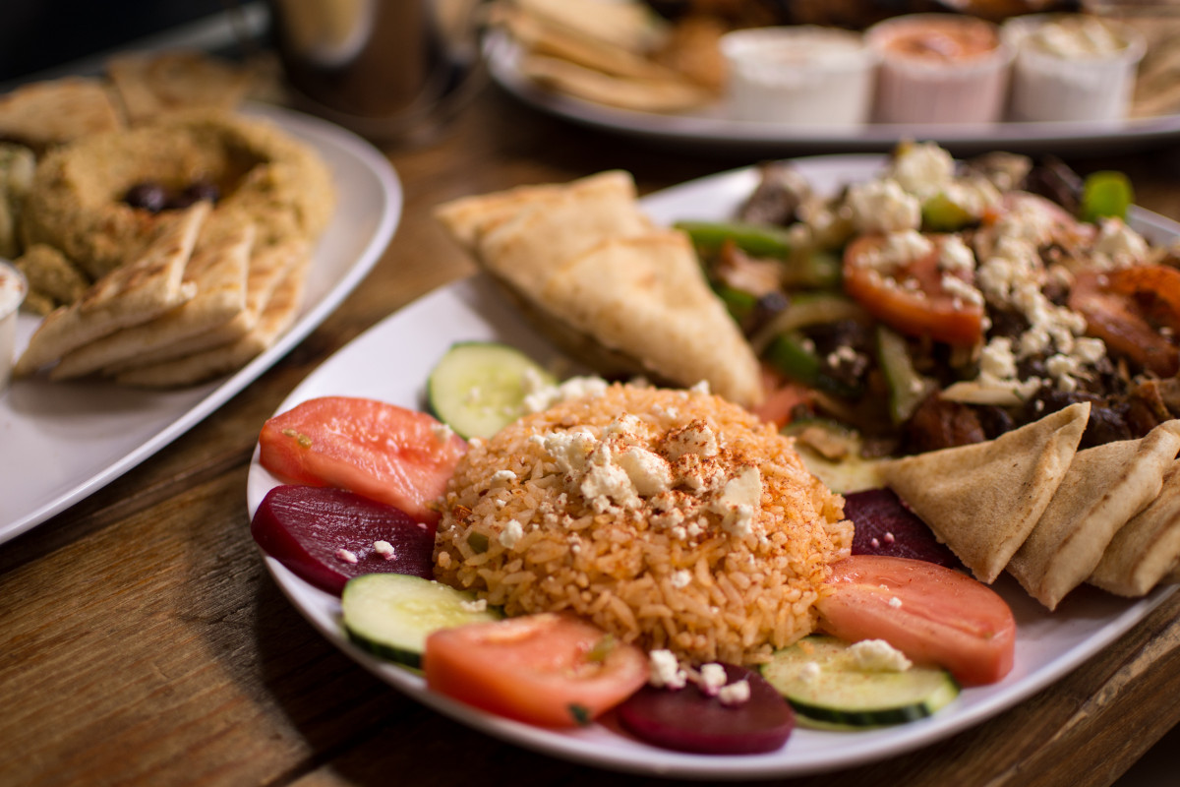
Recipe Website
-Navya Rastogi

Slide 2
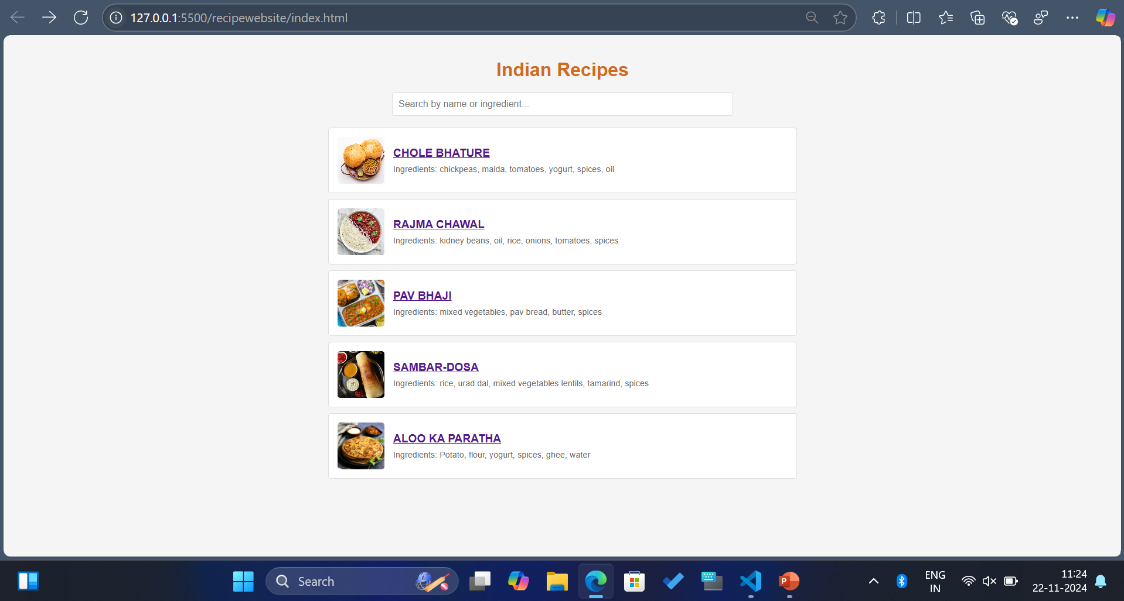

Slide 3
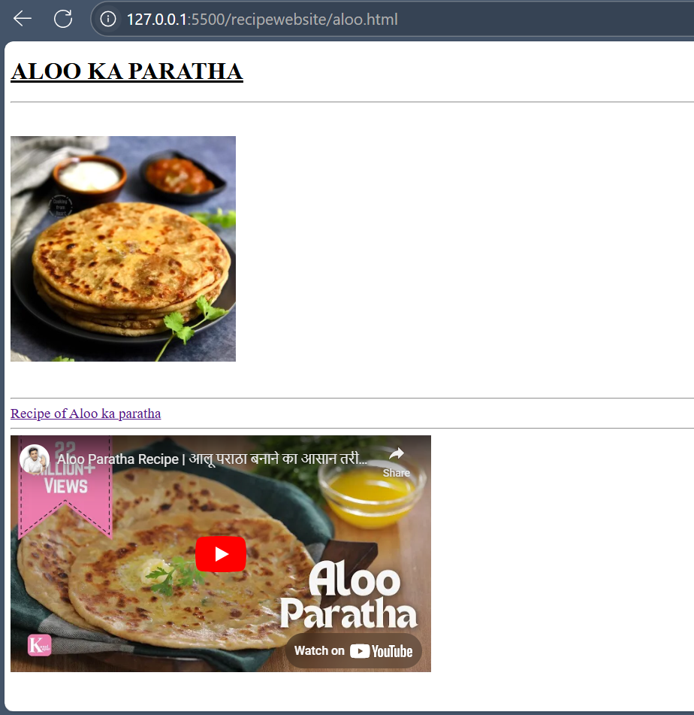
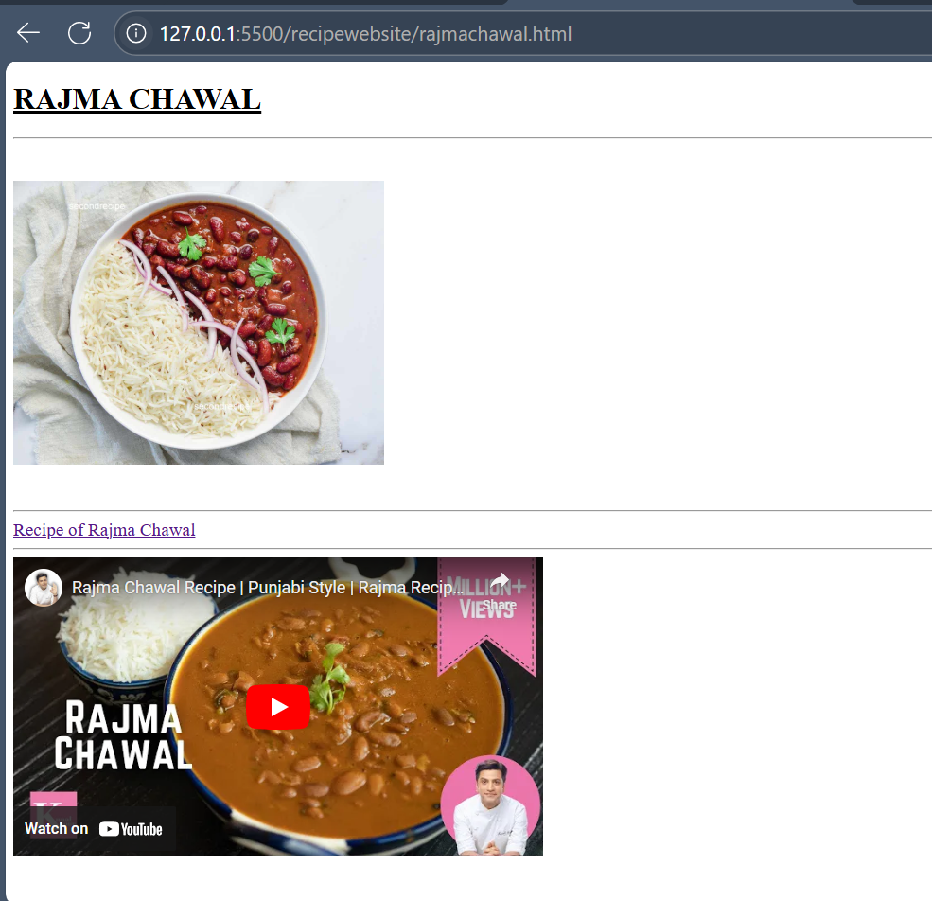

Slide 4
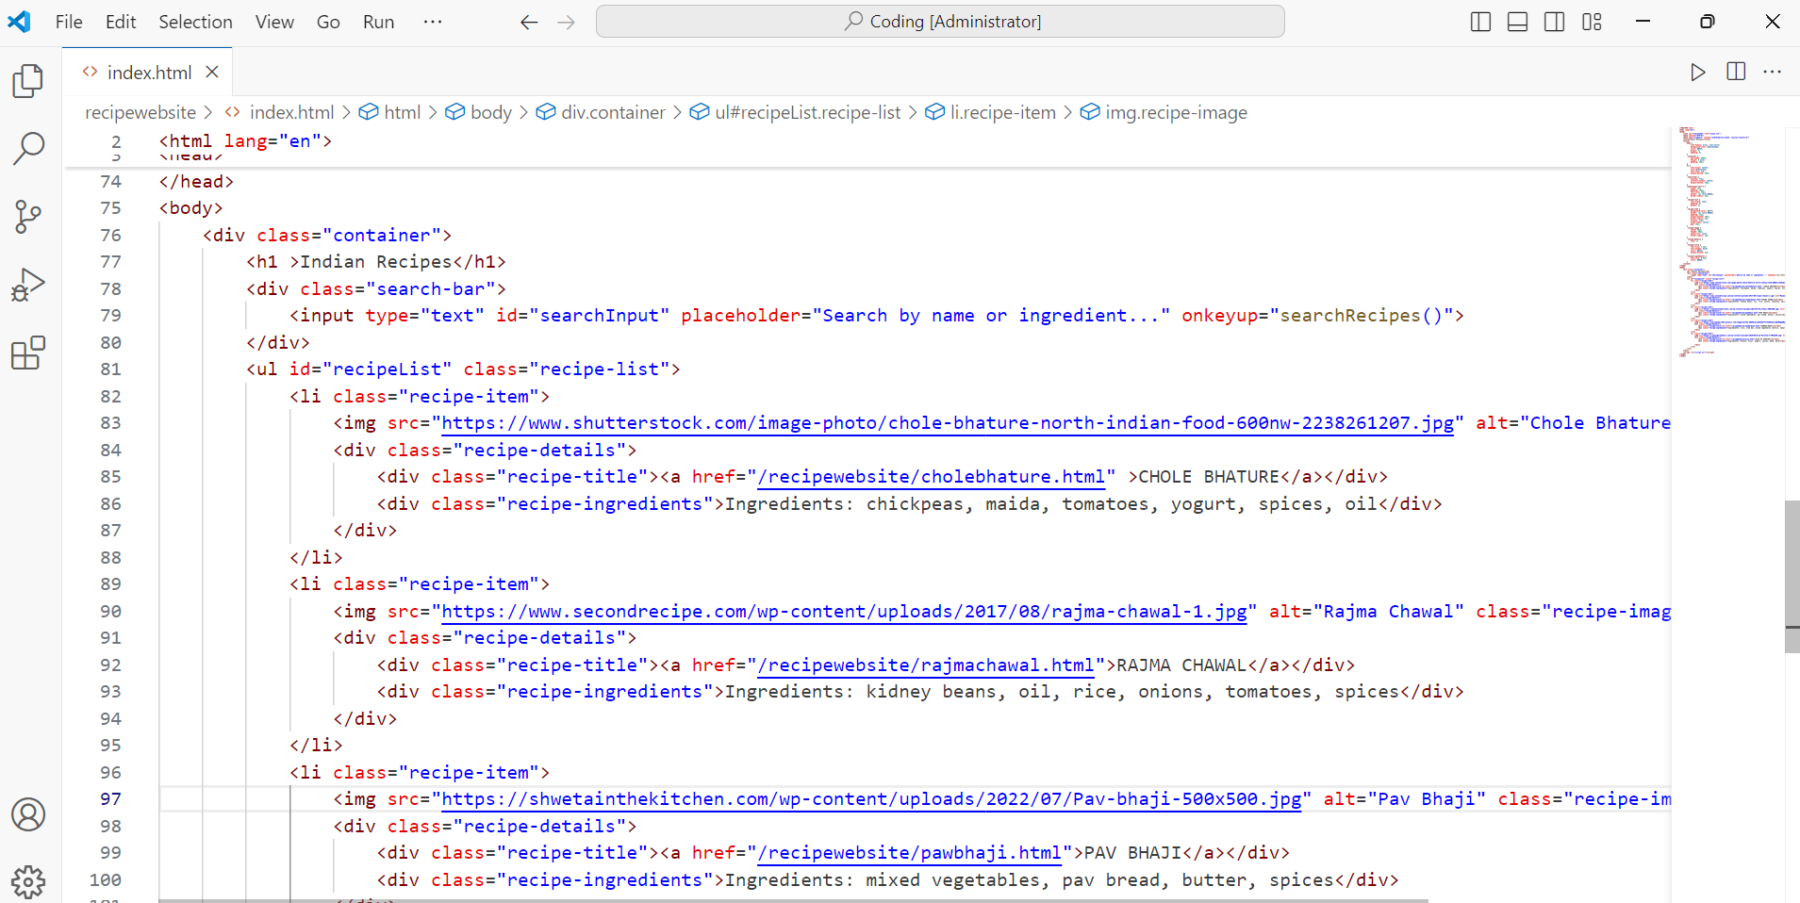

Slide 5
4 Quadrant approach

Slide 6
User Needs
Business Goals
Technical Considerations
Content Strategy

Slide 7
Empathy map

Slide 8
Does 1.Searches for recipes based on ingredients they already have. 2.Share recipes with friends on social media.
Says 1.”I don’t have time to cook.” 2. “I wish there was a way to arrange my recipes.
Thinks 1.”Is this recipe going to be easy to follow?” 2.”Can I make this with what I already have at home?”
Feels 1.Excited when discovering new meal ideas that are easy to prepare. 2.Overwhelmed by the number of options and choices available.

Slide 9
persona

Slide 10
Background
Name: Sarah Thompson
Age: 32
Occupation: Marketing Manager
Location: Urban area, New York City
Family: Married, no children (yet)
Challenge Faced Time constraints
Recipe overload Ingredient availability
Motivation 1.she wants to eat better and feels good about preparing her own meals.
2.Enjoy discovering quick,healthy recipes.
Goals 1.Cook meals that are quick and easy but still healthy. 2.Find a new meal inspiration regularly.
Technology Needs A user-friendly recipe website or app that allows for quick searches and provides organised recipe.

Slide 11
Thank you

